Slide 1
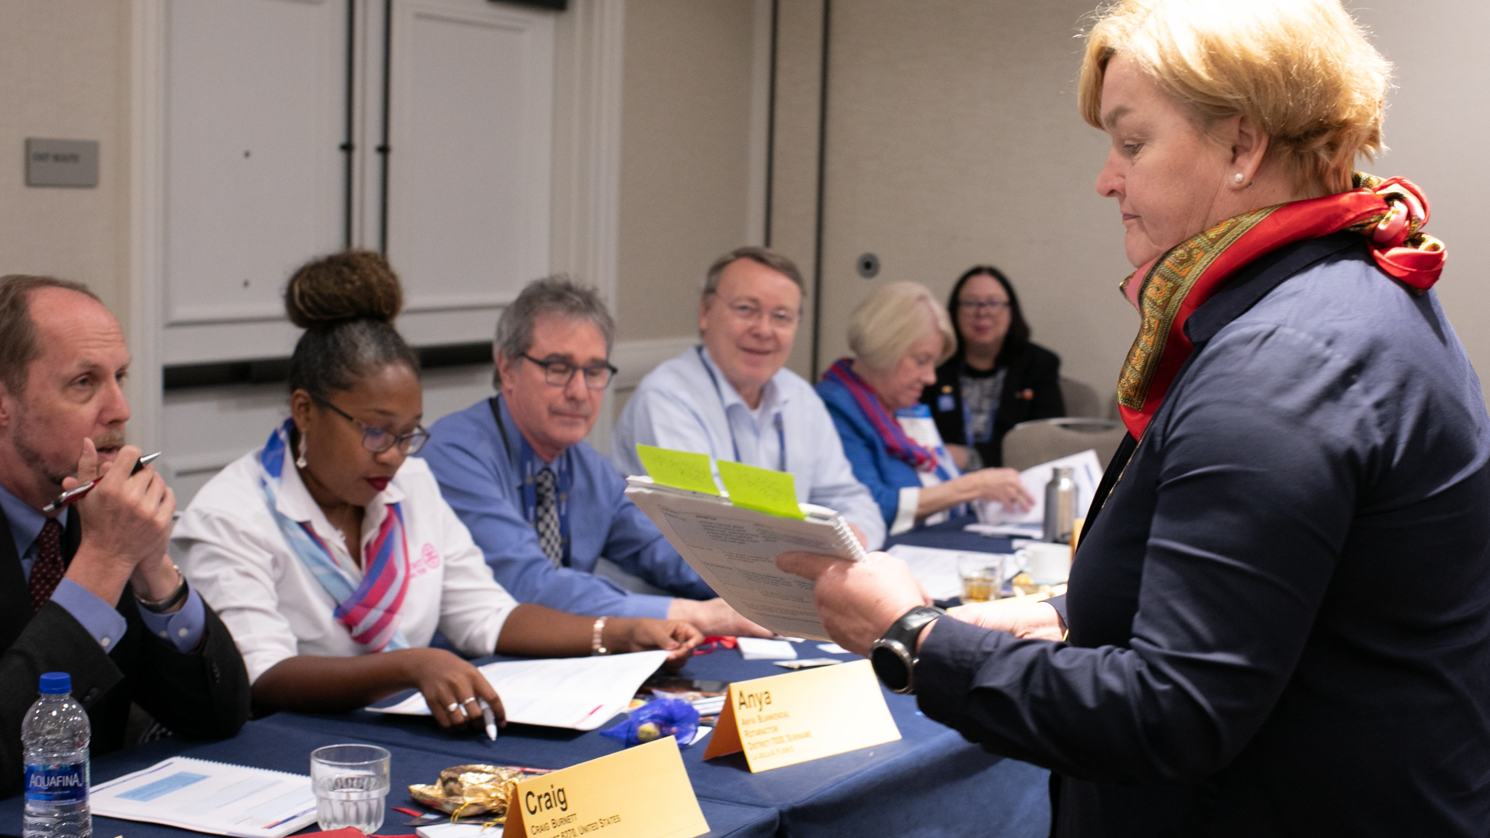
Learning & Development UPDATES
21 July 2023
Notes:
Welcome! My name is Kimberly Kouame and I work on the Learning and Development Team. I’m the Learning Resources Manager and my team oversees the Learning Center, creating content for role-based training, and leader’s guides for learning events like PETS.

Slide 2
Agenda
Council on Legislation Updates
PELS Curriculum Updates
Learning Center Data
Learning Center Features
Staying Connected
Learning Center Demo

Slide 3
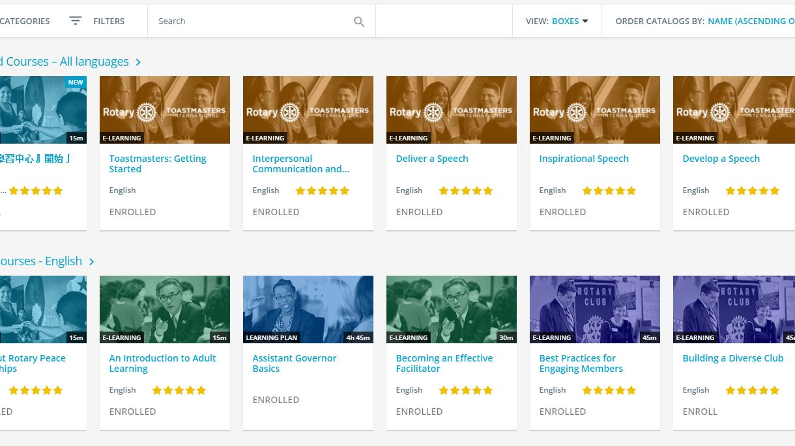
COL Updates

Slide 4
Presidents-elect Training Seminar shifts to presidents-elect learning seminar
To actively orient, engage, and empower presidents-elect
District Training Assembly shifts to club leadership learning seminar
To develop future club leaders
Event Name Updates

Slide 5
Dues increase
Per capita dues per half year:
2025-2026: $41.00
2026-2027: $42.57
2027-2028: $44.63
2028-2029: $46.50

Slide 6
New additions to governor responsibilities:
Working with district and club leaders to encourage:
  Promotion of the RI strategic plan
  Participation in grant programs of the Rotary Foundation
Providing support to assistant governors
Duties of the district governor
Notes:
Addition of DG responsibilities to promote RI strategic plan, grant programs and support AGs.
DGEs may want to consider embedding the Action Plan more explicitly into PELS events, highlight grant programs, involve AGs more in programming

Slide 7
Annual District Conference
Annual district conferences are now optional, but encouraged.
Any district elections or business matters must be put forward at a district conference or district legislative meeting.
Notes:
You can hold the district legislative meeting at PELS, CLLS, or a separate date and time for the meeting.

Slide 8
PELS Curriculum

Slide 9
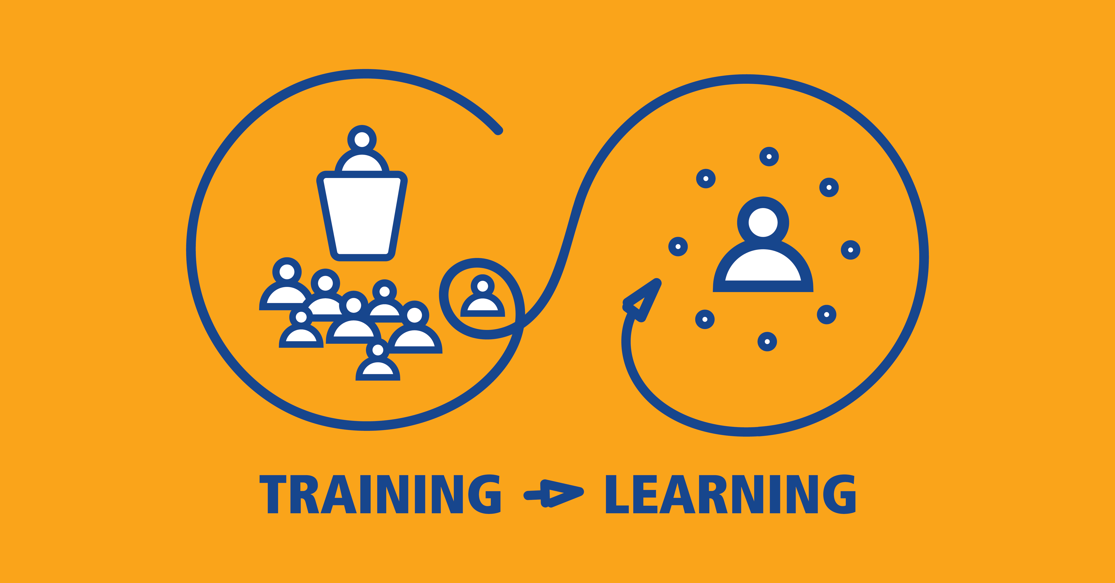
Notes:
I’d like to start by talking about our philosophy. In Rotary, we want learning to be fun and engaging and participant centered. Running a club should not feel overwhelming, many times incoming presidents can pull from past work experiences or past experiences within their club and apply them to this role. Facilitated sessions will help bring out those experiences into the room and you’ll have more ideas shared.
We often hear that all the information they receive is like a fire hose. One way to combat this is to help them through the online courses one at a time.
These courses are our foundational policies. They are build from policy and incorporate best practices to help our action plan move forward. If you have not taken a close look at your curriculum lately, we recommend that you do. These courses are required for presidents. They can serve as pre-PELS learning opportunities along with a few other tasks they will need to complete like getting a My Rotary account.
My recommendation would be to start in December or January and give them a different task every other week. Take this course and get a My Rotary account, ensure it’s connected to your club. Let them know you’ll be reminding them to take these courses over the next few weeks in hopes that they complete them before the in-person event. This will allow them to go at their own pace.
In our breakout session later we’ll take a deep dive into how it’s going at your events. We want to get that consistent messaging to all incoming club officers.

Slide 10
Build Curriculum from Online courses
Leader’s guides being revised to build off courses
Online content is for self-paced learning
In-person learning is best for sharing ideas in small groups, action planning, regionalized content, and finding solutions to our challenges.
Notes:
We’re asking that your in-person learning events build off what’s in the courses. We are building leader’s guides with the assumption that members took the online courses.
Online courses are best for self-paced learning of foundational information while in-person learning is best for idea sharing in small groups and regionalized content.
So it doesn’t mean, present the course content at your PETS. That would be redundant for those that completed the courses.
If members didn’t take the courses prior to the event, maybe they didn’t feel like they needed them, or maybe they plan to take them later when they have more time. If you replicate what’s in the courses, it’s repetitive and boring for participants who took them.
An example would be, as curriculum leads, take the course on Managing Club Business. If you want to have a breakout session on this topic because you think it’s important, don’t provide the same information again, ask the participants to get into small groups, share what they think will be the most challenging aspects and brainstorm ideas for overcoming those challenges.
Same with The Rotary Foundation. If they take the course prior to PETS, they will be prepared to discuss activating The Foundation in their club. If they are confused about what a specific program or fund is, have someone in the room explain it to them. Keep the focus on how to implement the programs of the Foundation in their clubs so they leave with actionable items.

Slide 11
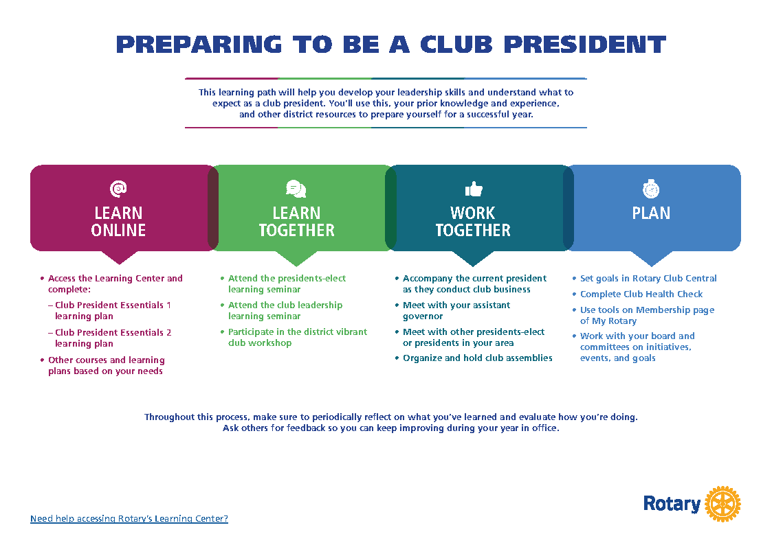
Notes:
We are in the process of updating this with the updated learning event titles.

Slide 12
Learning plan Naming update
BASICS & INTERMEDIATE → ESSENTIALS

Slide 13
Club president Essentials 1
Get Ready: Club President **
Managing Club Business **
Working With Your Club Leadership Team **
Minimizing Risk **
Rotary’s Action Plan and You
Best Practices for Engaging Members
Rotary Club Central Resources
Online Membership Leads
Rotary Foundation Basics
**Updated or soon to be updated courses
Notes:
Again the title change is because we have received feedback that members don’t want to take basic courses.

Slide 14
Club president learning plans
Is Your Club Healthy?
Vibrant Clubs in Action
Creating an Inclusive Club Culture
Committing to Diversity, Equity, & Inclusion **
Preventing and Addressing Harassment
Protecting Personal Data
Rotary’s Change Model
Protecting Youth Program Participants 2025-26 **
**Updated or soon to be updated courses
Notes:
Again the title change is because we have received feedback that members don’t want to take basic courses.

Slide 15
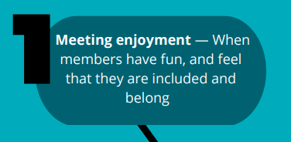
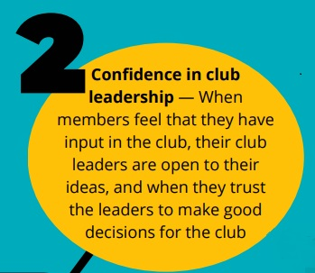
Club Experience Matters Most
Notes:
Personal Growth opportunities
Connections – helping members feel connected to others in the club
Meaningful service

Slide 16
PETS Leader’s Guide - Curriculum
Planning the Year Ahead
Conducting Meetings
Preparing to Lead
Engaging Club Members
Attracting New Members
Managing Your Club
Notes:
These are the main sessions that should be included in your PETS> This is very heavy on the business of your club and less focused on details like club logo and fundraising.

Slide 17
PETS Leader’s Guide – Optional Curriculum
Fundraising for The Rotary Foundation
Rotary Programs for Young Leaders
Service and Your Community
Telling Your Rotary or Rotaract Story
Using Social Media
Your Public Image Campaign
Notes:
Remember all club officers should be attending DTA including presidents, so they may be getting some of this during that meeting. Hopefully the PETS organizers are coordinating with DGEs so DGEs can build off this event and prepare DTA.

Slide 18
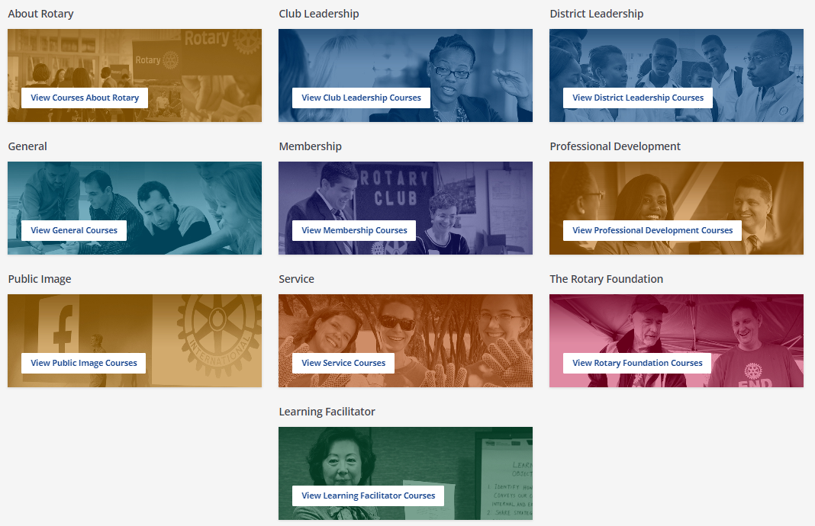
Notes:
We've started to change our language on the Learning Center from training to learning as part of our culture shift. This is a work in progress. This year we are updating a lot of courses. There will be a lot of updated courses available over the next 18 months to align with the COL changes.
I do want to point out these important resources in the Learning Facilitator course catalog.

Slide 19
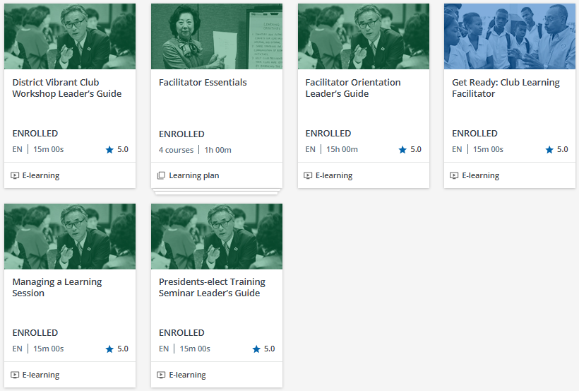
Notes:
This has basic information on how to facilitate in-person or online sessions. We recommend that anyone conducting training at the club, district, or zone level should complete the Facilitator Basics learning plan prior to the event. We also recommend hosting in-person practice sessions for your facilitators to practice their session and receive feedback from their peers, like what IA Learning Facilitators do to prepare for the International Assembly the week before governors-elect arrive. You can use the Facilitator Orientation to help you set this up.
Several of our Leader’s Guides are in here including the PETS LG which Amy Hopkins will be working to revise this year.

Slide 20
Data
Notes:
SPEAK SLOWLY KIM - Let’s look at data specific to Presidents and then we’ll get into some Learning Center data.

Slide 21
Course Completions by Zone
Notes:
As of 1 July 2025

Slide 22
2025-26 Club President Course progress
Notes:
* Preliminary data collected as of 21 July 2025. For Rotary Club Presidents Only.
This includes anyone with 88% complete or above since we made edits to some courses.
This year’s data is due to several forced data refreshes and auto enrollment rules along with requiring the courses.
We’ve had 1% more PEs complete the basic learning plan but 7% more PEs are in progress.
8% less complete the intermediate and 11% more are in progress with the CPI or CPE2 LP.

Slide 23
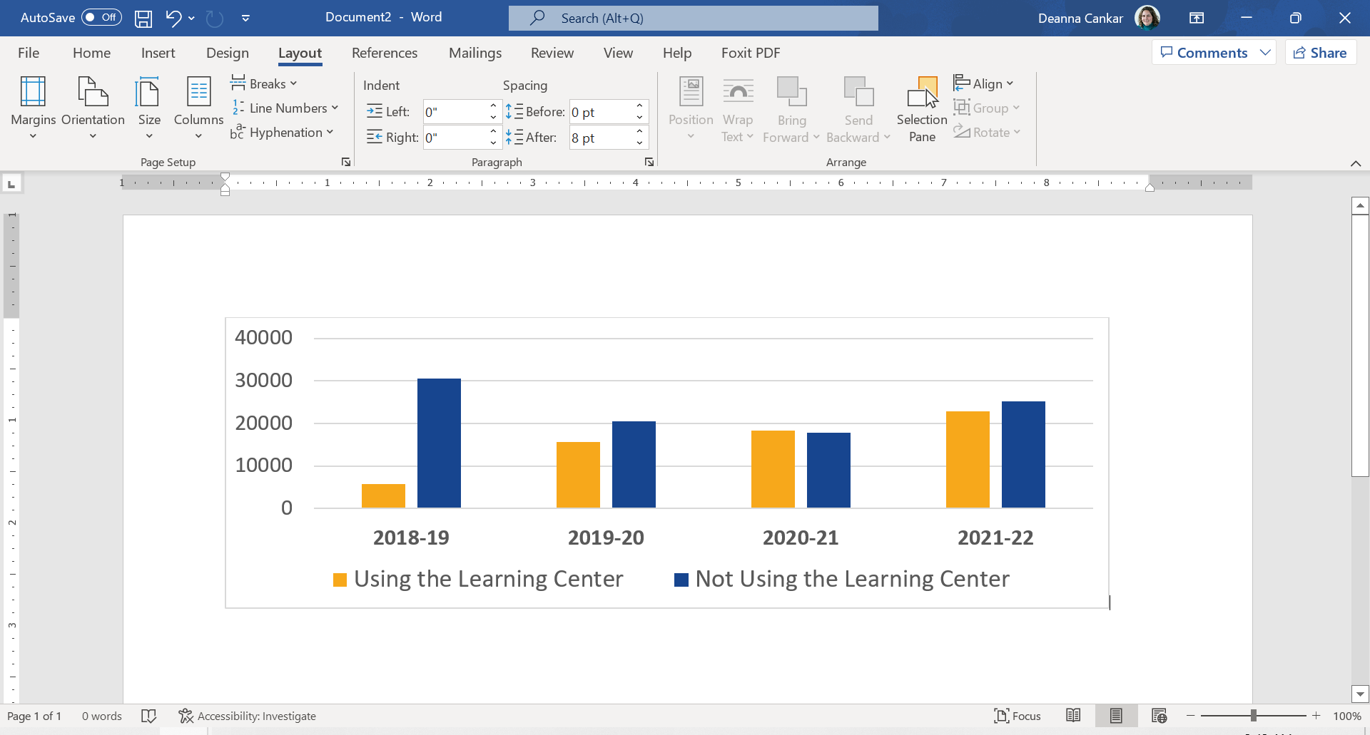
Percentage of Clubs using the learning center
2023-24
2024-25
43%
51%
51%
57%
49%
49%
23,454 clubs
29,573 clubs
Notes:
For 2024-25, numbers are based on 31 May 2025 club numbers.
94,749 unique MEMBERS visited in 2024-25 as of 30 June. For a 10% increase we would need 84,357 learners.
(in 2023-24 we had 70,000 unique MEMBER visitors). Our goal this year is 77,000 unique users.
113,148 Members and Non-Members as of 30 June. Which is a 33% increase from last year.
94,749 Rotarians and Rotaractors visited as of 30 June. Which is a 32% increase from last year.

Slide 24
Learning Center Features
Notes:
SPEAK SLOWLY KIM - Let’s look at data specific to Presidents and then we’ll get into some Learning Center data.

Slide 25

Customize Content
Create customized learning plans
Request a learning topics for your district or zone by topic or language
Reports for Multi District PETS
Notes:
You can email our team with a list of individual courses you would like to see in a learning plan. The benefit of this is if you are asking members to take a group of individual courses, we could give you one deep link and you can track progress of the learning plan on your reports.
You can also request us to set up a learning topic for your zone or district by topic or language. For example, we have a topic called District 5890 Expanding Our Reach only visible to members in D5890. We also have several catalogs for other languages. For example, we enrolled Chinese-speaking districts in a learning topic for Rotary Resources in Chinese. This reminds me if you speak a language not represented here, but members in your district translate Rotary materials into your local language, and you would like to post materials in a central location, you can use the Learning Center.

Slide 26
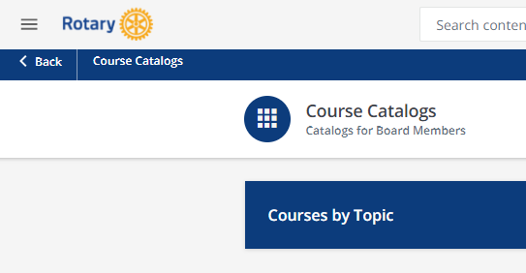
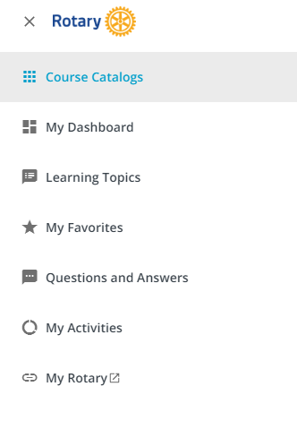
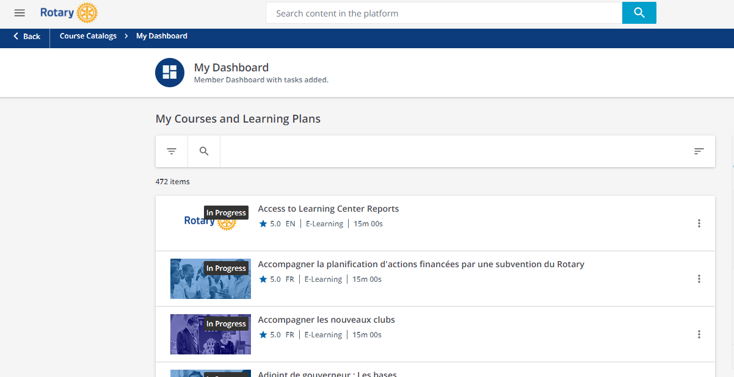
Get Access to Reports
1
2
3
Notes:
86% of districts have access to reports globally, while 96% have access to reports in North America.
First, if you don’t currently receive reports, and you are a DG, DGE, DGN, DT, DMC, or DRFC, you can complete the Access to LC reports and complete the course. Here are the steps:
Click the three lines at the top to access the menu
Choose My Dashboard
Click the Access to Learning Center Reports course. If it doesn’t appear on the top you can filter in the top right corner A-Z.
Complete the course and you should have access to reports the following Monday.
These members can share reports with other district committees, Ags or clubs if they are interested. The district leaders can decide if someone else needs to manage the reports and they can share them.

Slide 27
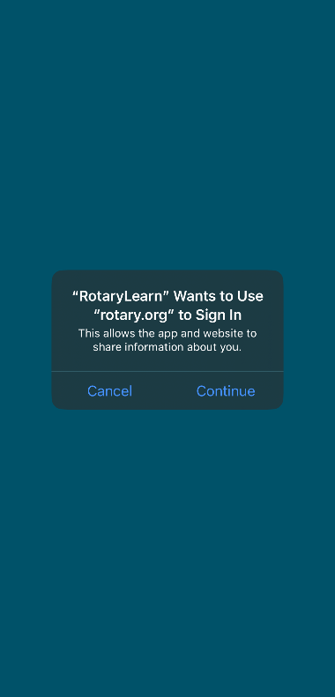
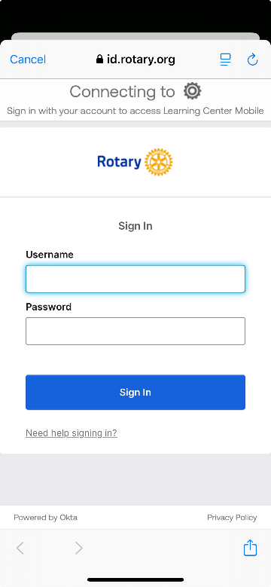
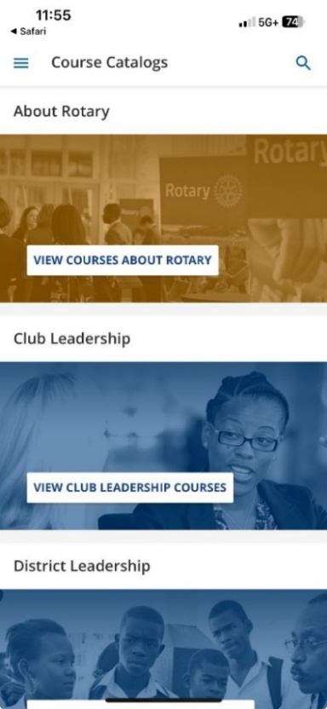

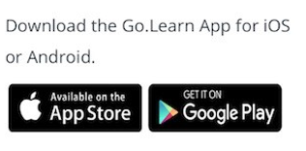
Rotary Learning Center app
Notes:
To access the Learning Center on your smartphone, please follow the steps in this guide: https://my.rotary.org/en/document/how-to-use-learning-center-on-mobile
Please note, if you’ve never been to the Learning Center before, you need to access it for the first time on a desktop or laptop computer and accept the privacy policy before using the RotaryLearn app on your smartphone.

Slide 28
Next steps for Presidents-elect
Get a My Rotary Account – Confirm it’s connected to your club
Visit the Learning Center on a computer
Download the mobile app and learn on the go
Complete Club President Essentials 1 prior to PELS
Notes:
With the curriculum and the features of the Learning Center, what should you have your PEs focus on?

Slide 29
Stay connected
Notes:
SPEAK SLOWLY MEGAN – Now that you’ve learned about all the content available and how to access the content, let’s look at how to stay connected to what’s new.

Slide 30
Emails from the Learning Center
learn@learnmail.rotary.org
Add this email to your approved sender list
Notes:
Emails with reports or reminders to take courses come from learn@learnmail.rotary.org. If you want to receive these messages in your inbox, you need to whitelist the email, or add it to your list of approved senders. If you don’t know how to do this, simply google “how to add an email as an approved sender in yahoo mail or whatever email server you have”

Slide 31
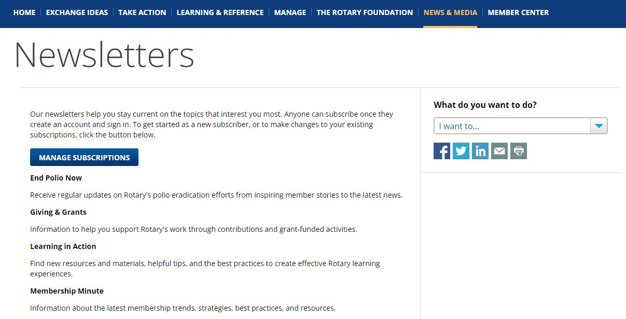
STAY CONNECTED:
Learning IN Action
Notes:
If you would like to receive communications from us about new courses or other information related to the Learning Center and more, you can go to My.Rotary > News & Media > Newsletters and manage your subscriptions. Be sure to select “Learning in Action” for updates.
Note that we are in the process of updating this page to reflect the new newsletter title to Learning in Action.

Slide 32
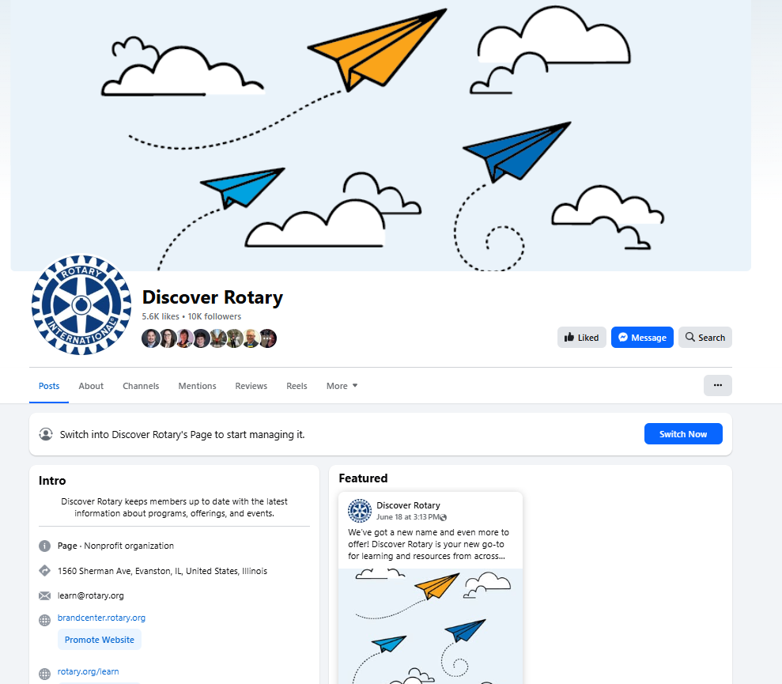
Stay Connected on Facebook & Instagram
Updated to include expanded content
Notes:
The Learning Center also has a Facebook page! Visit our page for new and revised course promotions, data, and tips. In addition, please share the page and any tips posted to your Facebook feed. This helps us spread the word to Rotarians about this great learning tool.
Use the posts we create, take only the EN image, and reshare it on your page.

Slide 33
QUESTIONS?
EMAIL LEARN@ROTARY.ORG
Notes:
If you should have any questions about the Learning Center or run into technical issues, you can contact learn@rotary.org for assistance.
Let’s take a few minutes to see if the audience has any questions. X is going to help share some questions to respond to.

